Slide 1
Extraction, Transformation & Loading

Slide 2
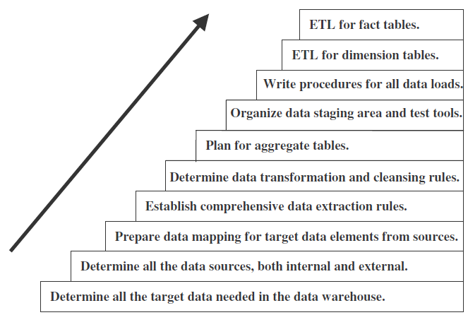
Major Steps in ETL Process

Slide 3
Types of activities that compose the ETL process
Combine several source data structures into a single row in the target database of the data warehouse.
Split one source data structure into several structures to go into several rows of the target database.
Read data from data dictionaries and catalogs of source systems.
Read data from a variety of file structures including flat files, indexed files.
Load details for populating atomic fact tables.

Slide 4
Continued…
Aggregate for populating aggregate or summary fact tables.
Transform data from one format in the source platform to another format in the target platform.
Derive target values for input fields (example: age from date of birth).
Change cryptic values to values meaningful to the users (example: 1 and 2 to male and female).

Slide 5
Data extraction

Slide 6
Data Extraction Issues
Source Identification—identify source applications and source structures.
Method of extraction—for each data source, define whether the extraction process is manual or tool-based.
Extraction frequency—for each data source, establish how frequently the data extraction must by done—daily, weekly, quarterly, and so on.
Time window—for each data source, denote the time window for the extraction process.

Slide 7
Continued….
Job sequencing—determine whether the beginning of one job in an extraction job stream has to wait until the previous job has finished successfully.
Exception handling—determine how to handle input records that cannot be extracted.

Slide 8
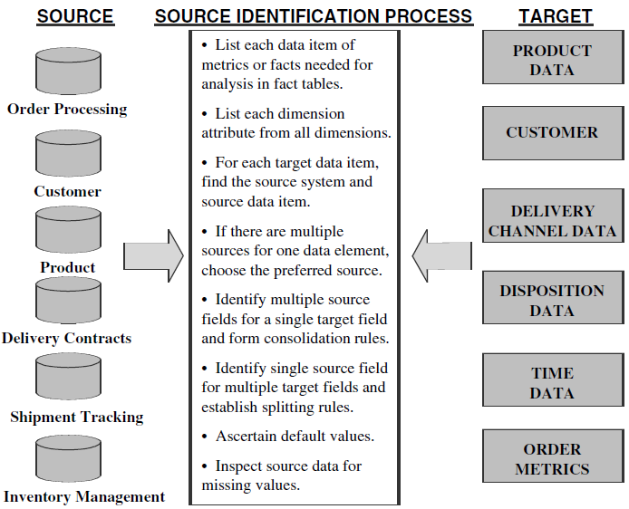
Source Identification

Slide 9
Data Extraction Techniques
Can u Store historical data
in Operational tables ?????

Slide 10
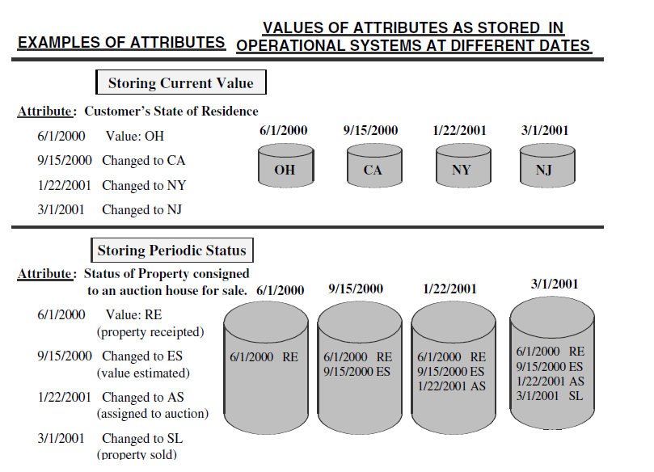

Slide 11
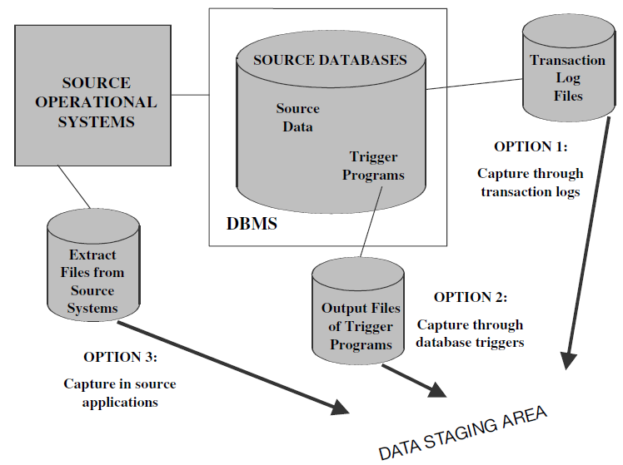
Immediate DATA Extraction

Slide 12
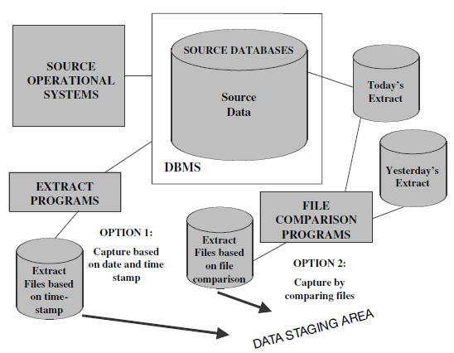
Deferred data extraction

Slide 13
Data Transformation

Slide 14
Basic Tasks
Selection
Splitting/Joining
Conversion
Summarization
Enrichment

Slide 15
Major Transformation Types
Format Revision
Decoding of fields
Calculated and Derived Values
Splitting of Single Fields
Merging of Information
Note: It is not opposite of Splitting… Merging means Merging from various sources

Slide 16
ContInued….
7. Character set conversion(EBCDIC→ ASCII)
8. Conversion of units o Measurement
9. Date-Time Conversion
10. Deduplication
11. Key Restructuring

Slide 17
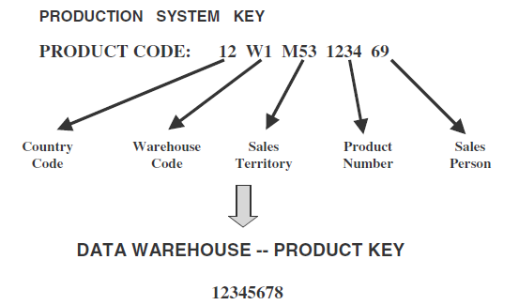
Key Restructuring

Slide 18
Data Loading

Slide 19
Terms in Use
Initial Load—Populating all the data warehouse tables for the very first time
Incremental Load—Applying ongoing changes as necessary in a periodic manner
Full Refresh — Completely erasing the contents of one or more tables and reloading with fresh data (initial load is a refresh of all the tables)

Slide 20
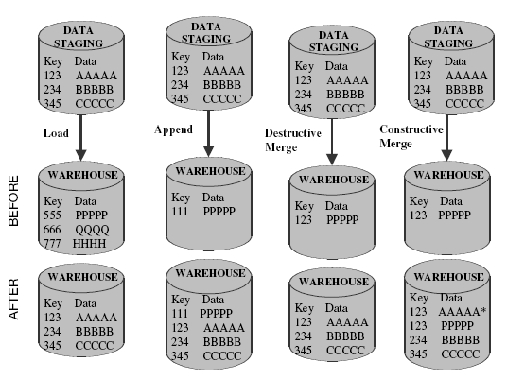
Modes of Applying Data

Slide 21
Creation of Indexes

Slide 22
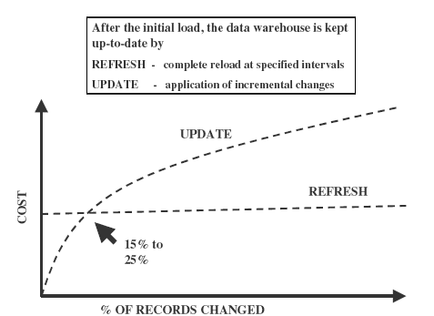
Refresh and Load

Slide 23
Now what "we "missed when "you" were shouting……

Slide 24
Fact table sizes

Slide 25
Aggregate fact table and derived dimension table

Slide 26
Forming Aggregate fact tables

Slide 27
Fact Constellation
Multiple fact tables share dimension tables.
This schema is viewed as collection of stars hence called galaxy schema or fact constellation.
Sophisticated application requires such schema.

Slide 28
Fact Constellation

Slide 29
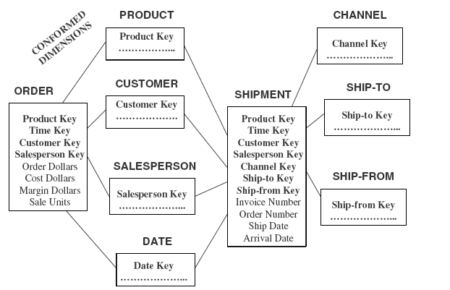
Example

